Slide 1

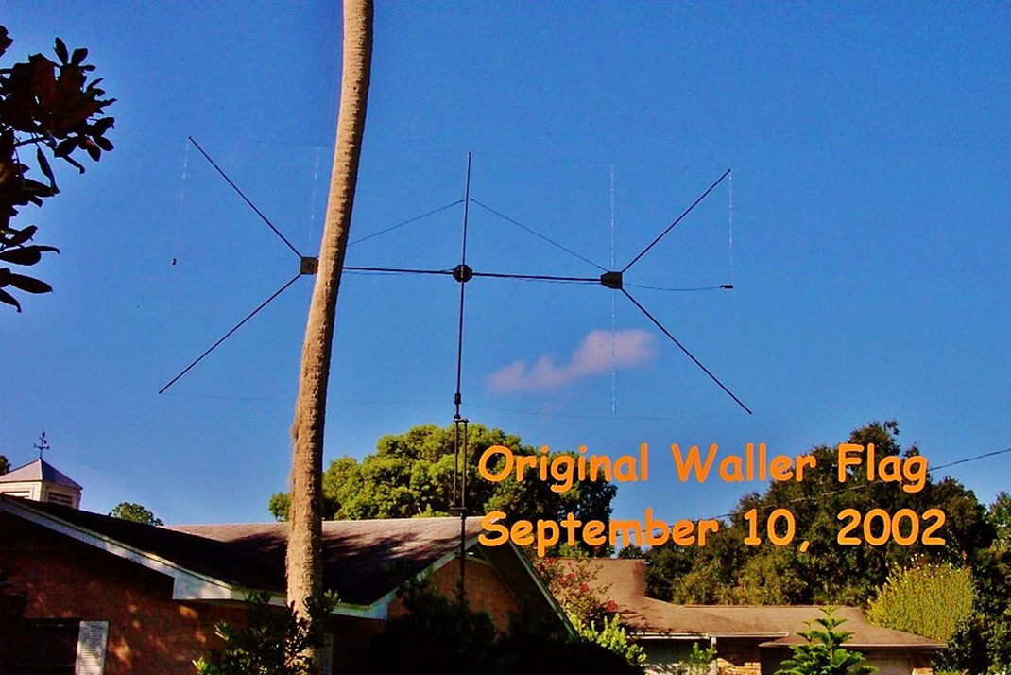
Waller Flag
RX Antenna 101
How to Construct a WF
Jose Carlos N4IS
Notes:
Thanks to K4ZW Ken Claerbout to invite and put this Webnair

Slide 2
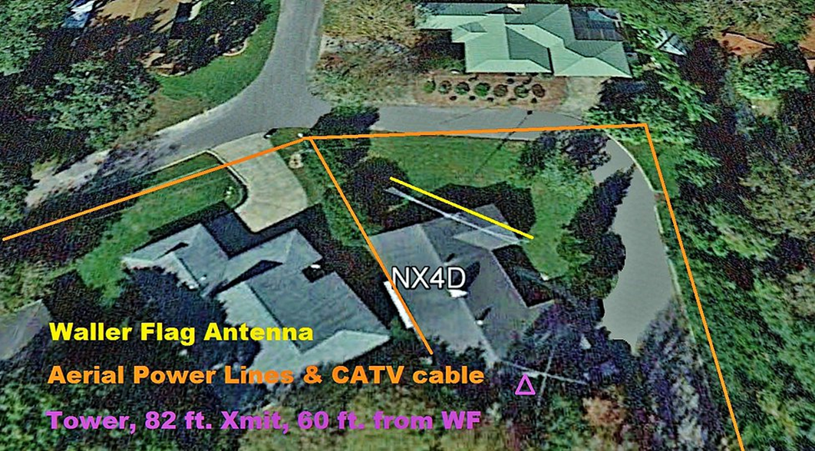
High performance receiving antennas for small lots (2016)
Waller Flag RX Antenna 101
How to Construct a WF
What is a Waller Flag
Phasing lines and transformers
Phasing lines, resistors and chokes
Horizontal or vertical WF
Common node noise & detuning TX antennas
Preamplifiers, filter and R/T switches
How to measure pattern (polar plot)
How to test and evaluate results.
NX4D Doug Waller QTH 1/5 acre city lot subdivision
309 countries heard on 160m
298 worked 2003 to 2016 40 zones since 2011
Average of 2 new countries every! Month!
Average of 24 new countries every! Year!
13 years in a row! >> http://nx4d10.wix.com/waller-flag
NX4D worked 7 new ones on 160m during 2016 now with # 303
N4IS worked 10 new ones on 160m during 2016 now with # 289
Notes:
Welcome to the Webnair
Agenda for next hour
Update on DXCC NX4D and N4IS
Visit NX4D website for more information and pictures.

Slide 3
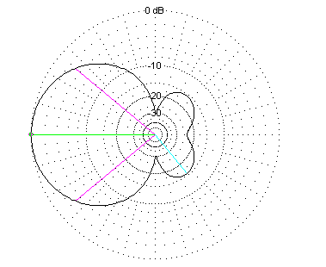
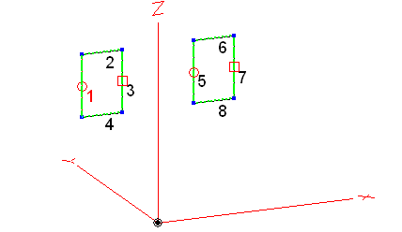
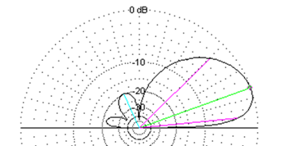
Waller Flag RX Antenna 101
How to Construct a WF
Understanding the problem before finding the solution
What is a receiving antenna
Receiving antenna & Transmit antenna used for receiving
  Directivity gain = RDF > improves signal to noise ratio, the Waller Flag has 11.5 to 12 db RDF
  Equivalent long boom 3 elements YAGI
  Efficiency or antenna loss > isolation between TX and RX, the Waller Flag gain depending on size and location -20db to -60 db
What is a Waller Flag
http://wwrof.org/webinar-archive/high-performance-rx-antennas-for-a-small-lot/
Notes:
Understanding the problem
Receiver antenna isolation 30 db or more
Antenna is defined by antenna directivity gain and antenna gain = antenna directivity x efficiency
Receiver antennas has loss it means low antenna gain
Comparison and other antennas, please visit Archives

Slide 4
What is a Waller Flag
The Waller Flag is a receiving antenna with two electrically small terminated loops phased end fire.
Two Flags phased 180 degree
signal
Resistor
Notes:
Electrically small loop maximum radiation in the plane of the loop
Large electrical loop maximum radiation perpendicular to the plane of the loop
Small loops has null at the plane
The WF is two small terminated loops in end fire phase

Slide 5
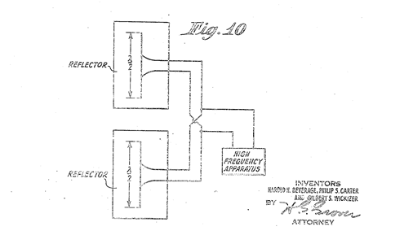
What is a Waller Flag
1938 Harold Beverage invented wide band receiver antenna, loaded loop. The present invention relates to short wave antennas and, more particularly, to antennas for receiving horizontally polarized waves over a wide band of frequencies. An object of the present invention is to enable the reception of horizontally polarized signals over a wide band of frequencies such-as is at present used in television.
https://docs.google.com/viewer?url=patentimages.storage.googleapis.com/pdfs/US2247743.pdf
Waller Flag is a Harold Beverage antenna
Notes:
The terminated loop antenna was invented by Harold Beverage in 1938 and patent my RCA for TV broadband receiver antenna
See Dual loaded loop receiving antenna Historical Evolution
Download the slides , it has more information nor covered on the audio section

Slide 6
What is the Waller Flag size
Electrically small loop < 1 / 10 λ
Terminated loop with a resistor
Frequency dependent gain
Frequency independent RDF
160m/10
6 x 2 m loop
signal
80m/10
3 x 1 m loop
40m/10
1.5 x .5 m loop
Transformer
EWE
Resistor
WF 160m >>>
14ft. x 7 ft.
or
4m x 2m
20 ft. x 10 ft.
or
6 m x 3m
24 ft. x 12 ft.
or
8 m x 4 m
Single Flag
Notes:
The EWE is half the FLAG
450 ohm resistor
Image is ground dependent
Single Flag,K9AY, SALA and other single terminated loop.
Changing the size does not change the radiation pattern
The gain increase with area and frequency

Slide 7
What is the Waller Flag size
If RDF is the same, can I build a WF with 2m x 1m loop and 5m boom ?
  YES, the gain will be very small but it does work
How small can the loop be?
  The loop thermal noise is the limit for size, the signal output below the sensitivity of the preamplifier or below noise floor of the system.
Dr. Dallas Lankford, wrote the Flag Theory and design the Quad Flag Array >> Dallas Files The derivation which follows is a variation of Belrose's classical derivation for ferrite rod loop antennas,“Ferromagnetic Loop Aerials,” Wireless Engineer, February 1955, 41– 46.
  The Dallas Files are now found here: http://groups.yahoo.com/group/thedallasfiles2
Notes:
DRF does not change, so what size to build the WF?
Low noise figure helps to hear weak signal, not the gain
Very small 1m x 1m loop and a 100 db gain preamp does not work
The loop thermal noise is the limit for size
Dr Dallas derivate is a variation of Belrose's classical derivation for ferrite rod loop antennas,
“Ferromagnetic Loop Aerials,” Wireless Engineer, February 1955, 41– 46.
Measurements have confirmed that the flag signal to noise formula
Very interesting reading
Also confirmed using SPICE MODEL

Slide 8
What is practical recommended Waller Flag size for 160 to 40m
WF with 14 x 7 ft. loops , 24 ft. boom, has been measured and proved to be above thermal noise limited on quiet rural locations with -125dbm noise
So .. Why do we see BIG and MONSTER WF’s?
  The answer for that question is the gain versus local noise. During quiet winter mornings the propagation noise can be really low as 80 Kelvin or near -140 dBm, with -50db gain the DX signal can would be below the MDS of the receiver but with -40 db gain the signal could be just enough above noise for a QSO.
WF recommended sizes
  For most locations 14 x 7 x 30ft boom ( 4 x 2 x 8 m)
  For quiet locations 20 x 10 x 50ft boom ( 6 x 3 x 12 m)
Dimension is not critical, all sizes works, but symmetry is a must
Notes:
Dimension is not critical, all sizes works
The loop dimension is important to be the same on both loops
Cut the two wires together.
The poles or arms can be - + one inch length
Two recommended proofed sizes
Small for 200 DXCC on 160m
Big for 300 DXCC on 160m
Both good for 300 DXCC on 80/40/30, also 60 f0r sure

Slide 9
Doug Waller NX4D original WF
Doug worked JT1CO on 160 over the north pole using the first Waller Flag bellow
http://nx4d10.wixsite.com/waller-flag
Notes:
Doug original sketch , 100 of copies since 2003

Slide 10
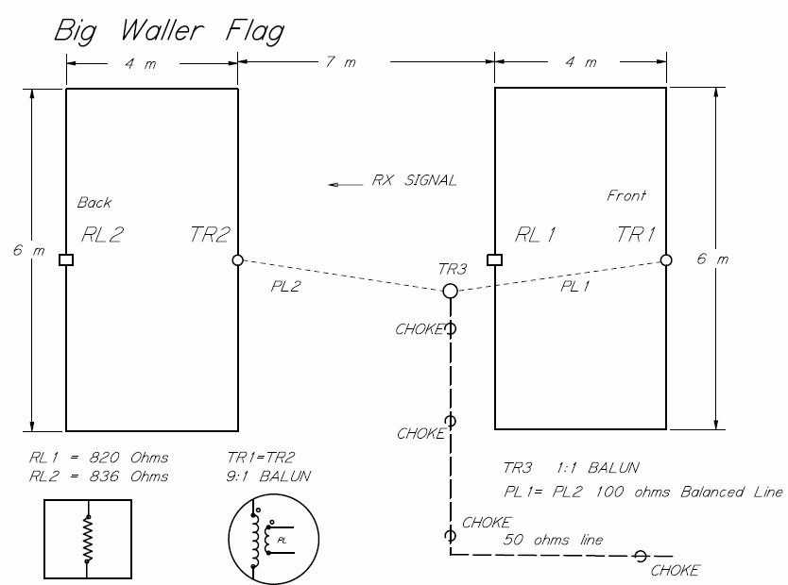
N4IS Big WF
JC worked 4W6A on 160 direct path using the Big Waller Flag bellow, excellent results for more than 10 years.
Notes:
N4IS Big Waller Flag
Not necessary anymore with new preamps
That time I was limited to 20 db gain
common mode noise was s7 with no antenna connected
10 years developing all things mentioned here today
Take advance this is a unique presentation one time only

Slide 11
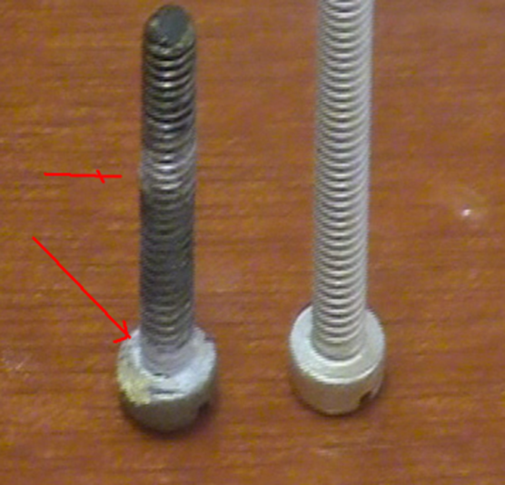
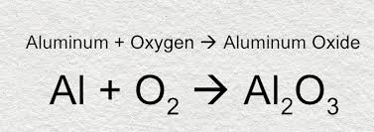
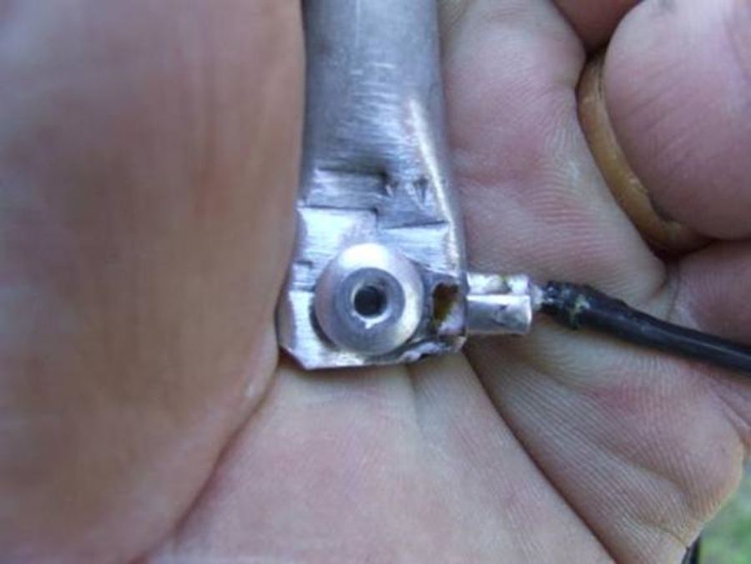
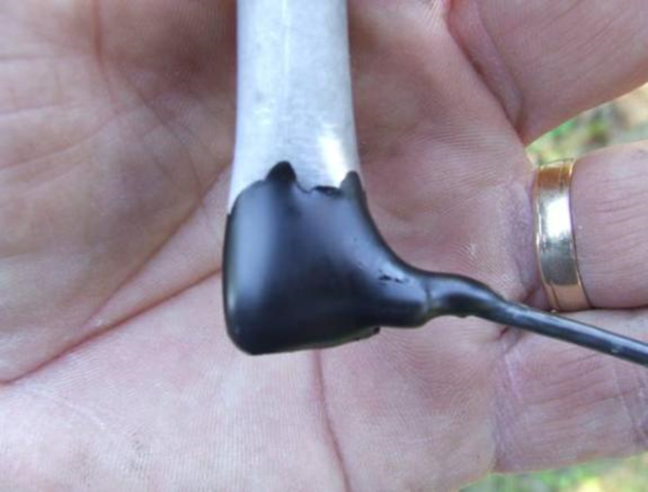
Aluminum Oxide is not a conductor and forms diodes
Mixing different metals generate a HUGE NOISE on 160m
Fiberglass poles and
#13 - # 18 copper wire
RF energy near sunset is intense, some TX antennas can show several milliwatt of signals
diodes generate intermodulation, raspy, and
rough noise on 160m
LAST ONE YEAR MAX.
Notes:
I suffered two year with this terrible noise problem
Doug did not have this noise problem
W8VVG is the only one I know that was able to use all aluminum WF
Larry use tube and not wire on the loop.
Most location is not possible to use aluminum and copper wire.
I gave up to fiberglass and copper wire.
Recommend Wireman

Slide 12
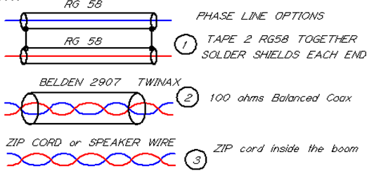


Waller Flag phasing lines
BALANCED
Imbalance capacitance to the ground
FIBERGLASS
MAST
DO NOT RUN TWISTED PAIR NEAR GROUND or METAL
SIGNAL
1:1
Aluminum boom > shielded line
Fiberglass boom > unshielded line
100 ohms
100 ohms
CHOKE
9:1
9:1
50 ohms
Notes:
Phasing lines balanced due capacitance to ground
No common mode noise if capacitance the same
Like microphone wire
Twisted pair from CAT5 or 6 cable are excellent , but don’t last
Need to strip the cable
Boom can be aluminum. Note the phasing line inside one loop and not on the other
HWF boom loads the tower, as well the loop, high isolation necessary

Slide 13
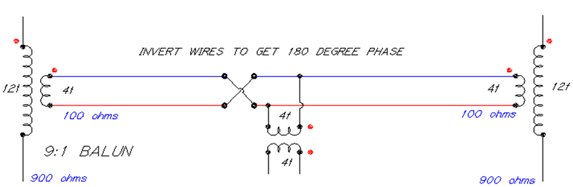
Waller Flag phasing lines
There is only one way to connect the phase correct
FOR HORIZONTAL WF
TRANSFORMERS 1 KW
RESISTORS 10W (900 joules)
ISOLATION 10KW
THE HWF LOADS THE TOWER
wrong wire at the center
wrong wire front transformer
wrong wire back transformer
wrong phase front transformer
wrong phase back transformer
wrong side of loop
twist the too loops
There are seven ways to connect the phase wrong
Notes:
There are more ways to get it wrong,
Resistor and RF energy
Phase means the voltage is increasing whit time the same way on all wires on the same phase
180 degree means voltage is going on different direction

Slide 14
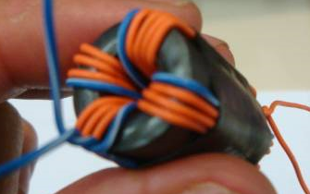
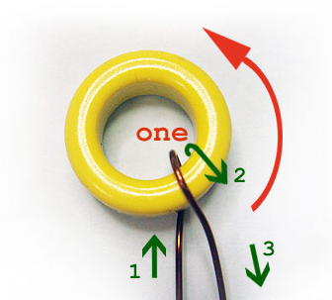

Waller Flag transformers
CENTER
CLOCKWISE OR
COUNTER-CLOCKWISE
ALL TOROIDS WINDING
BINOCULAR
USE WIRE REFERENCE
COMING FROM THE CENTER
ALL TOROIDS WINDING
TOROID MATERIAL # 31
Notes:
Material #75 or #77 or # 31 ONLY
No #41 or #61 those are for 30 MHz up

Slide 15
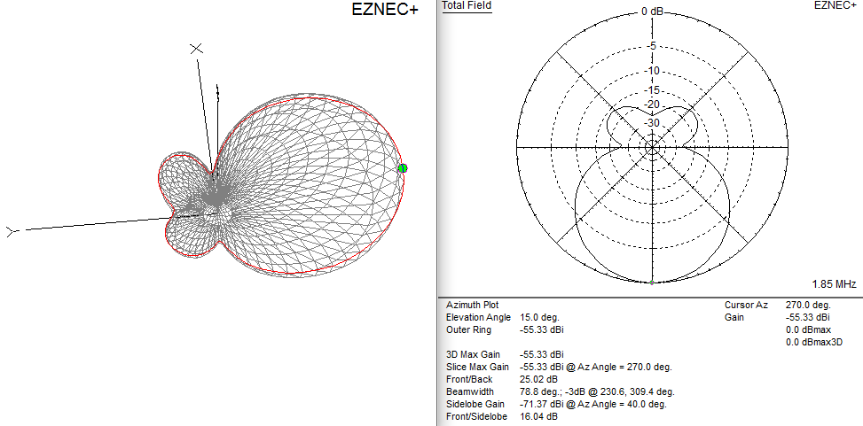
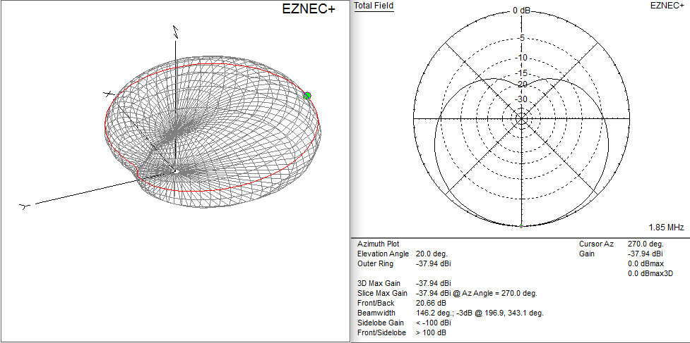
WF with 180 degree phase
Gain = -55.33 dBi
Front back = - 25 dB
Front side = -27 dB
WF with 0 degree phase
Gain = - 37.94 dBi
Front back = - 20.6 dB
Front side = - 5 dB
Notes:
Wrong phase has higher gain , easy to notice the noise increase and lack of directivity
HWF test with 40m horizontal signals
VWF test with BC AM signals

Slide 16
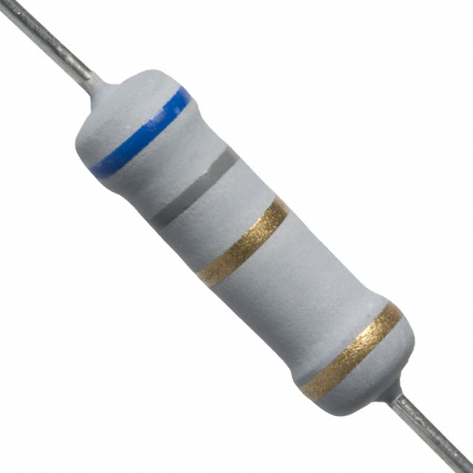

Waller Flag resistors
FIBERGLASS
MAST
USE NON INDUCTIVE RESISTORS
SIGNAL
L F
1:1
L B
100 ohms
100 ohms
KEEP LOOP REATANCE LOW
VWF R ( 3W ) near 900 ohms
HWF R (10 W) near 1000 ohms
CHOKE
9:1
9:1
50 ohms
FT > Front Transformer
FR > Front
Resistor
BT > Back
Transformer
Back
Transformer
NTE 3W METAL FILM
BR = FR + 10 to 24 ohms ( 1% low temperature drift and non inductive)
FR = BR 180 degree >> best broadband, deep side null
BR = FR + 10 to 24 ohms is equivalent to 175 degree Front back increase and RDF decrease
BR = FR + 50 ohms or more is equivalent to 170 degree Front back increase , side null and RDF decrease
VISHAY/DALE NS-10 1k OHM 10W 1% RESISTOR
Notes:
Measure the resistors with a meter
Care with water to rust the leads
Low temperature drift
Parallel 3w is 10w not available

Slide 17
Waller Flag phasing lines
FIBERGLASS
MAST
KEEP SWR LOW 1:1.5 SWR or better
SIGNAL
L F
1:1
L B
100 ohms
100 ohms
CHOKE
9:1
9:1
50 ohms
FT > Front Transformer
FR > Front
Resistor
BT > Back
Transformer
BR > Back
Resistor
LF = LB + 2 to 4 ft. ( 1 to 2 m )
LF REF = 0 degree = LB =180 degree >> best broadband
LF REF = 0 degree < LB =175 degree Front back increase and RDF decrease
LF REF = 0 degree > LB = 185 degree Front back decrease and RDF increase
Notes:
SWR MUST be low, otherwise the current will be different and the phase will be wrong
The feed line must be high quality, RG58 is not recommended
Only RDF helps digging weak signals. Front Back does not help you much

Slide 18
Waller Flag optimization
VERTICAL WF
HORIZONTAL WF
Optimize for maximum RDF
For noise locations
  Adjust resistors for good front back at low elevation angle (0.1degree) to reduce local manmade noise
Optimize for maximum reduction of manmade noise
  SAME resistors RF = FB
  SAME phase line length FL = BL 180 degree
The Waller Flag is grounded independent
SWR should be maximum 1:1.5 from 1.8MHz to 7 MHz
1:2.0 is ok for 10 MHz and up.
SWR is the same at 3 ft., 30ft. or 120 ft. above ground
Notes:
Don’t install a WF is the SRW is high, you will need to take it down later.

Slide 19
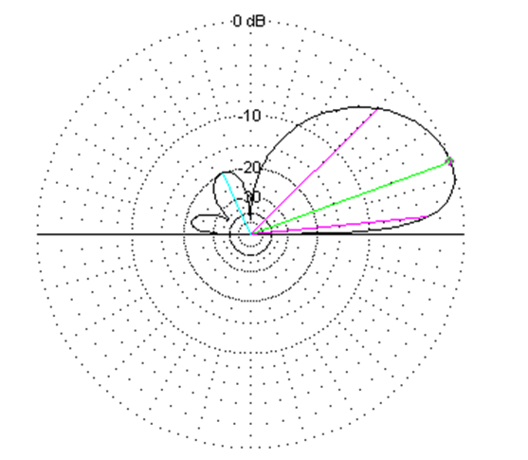
Vertical Waller Flag VWF
Signal intensity
VWF Vertical Waller Flag 11.5 to 12 db RDF
Transmit antenna noise level ( 5dB RDF)
Single Flag noise level
13 dB
Flag noise level
DX3
DHDL noise level
DX 4
WF noise level
Vertical RDF 5 dB > WF 11.5 dB ( 6 ) = 9 to 12 dB S/N improvement
DX 3 very comfortable copy on the WF
DX 4 below noise level on the FLAG and the DHDL
WF copy DX4 UNBELIEVABLE !!!!
One hour time near sunset or sunrise
Notes:
See last Webnair on archives
4W6A , BU2AQ, JT1CO, very rare and weak signals for a city lot
But noise is up.
Can be compare only with a rotatable antenna
13db improvement on signal to noise ratio is a proved number in the last 20 years using a WF

Slide 20
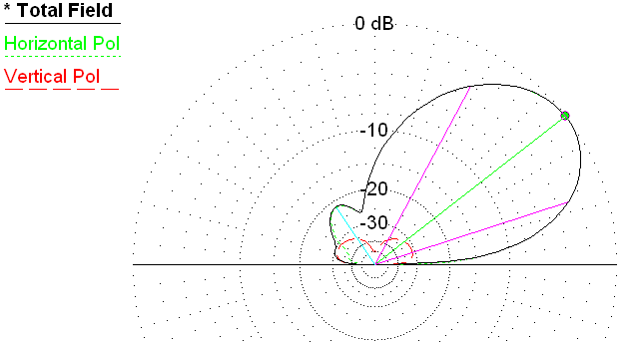
Horizontal Waller Flag HWF
FOURTH STEP >> Polarization filter HWF 11.5 to 12 dB RDF
Signal intensity
TX ant noise
- 30 db
Single Flag noise level
22 db to 30 db
DHDL noise level
The HWF attenuate vertical polarized signal > -30 dB
Detuning the tower the HWF improves S/N another 6 to 8 db = 38 db
Removing local ground wave noise the HWF noise floor is >10 dB better
DX 4 very comfortable copy on the HWF
HWF copy DX4 for long time with much better SNR
HWF can hear DX 5
HWF can hear what others can’t , and anywhere, even a city lot
DIGITAL Modes JT9 or JT65 can experience 18 dB more in SNR
VWF noise level
DX5
DX 4
HWF noise level
One hour time near sunset or sunrise
Notes:
Explain the chart Intensity & time one hour SS or SR

Slide 21
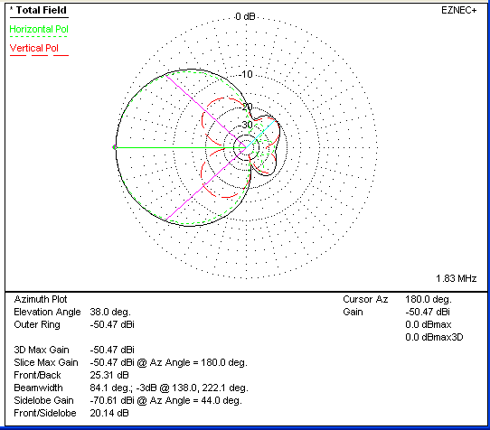
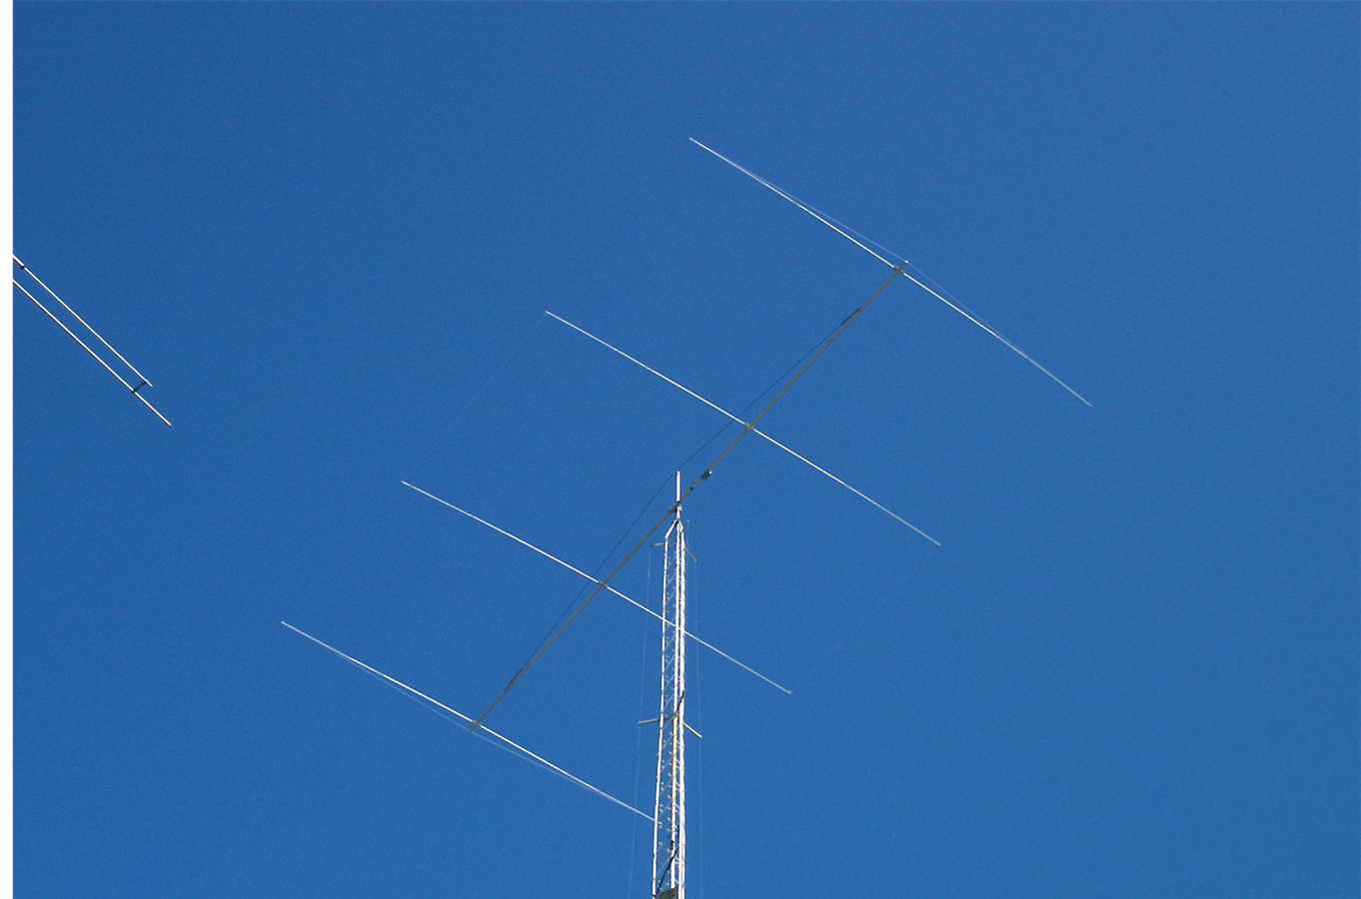
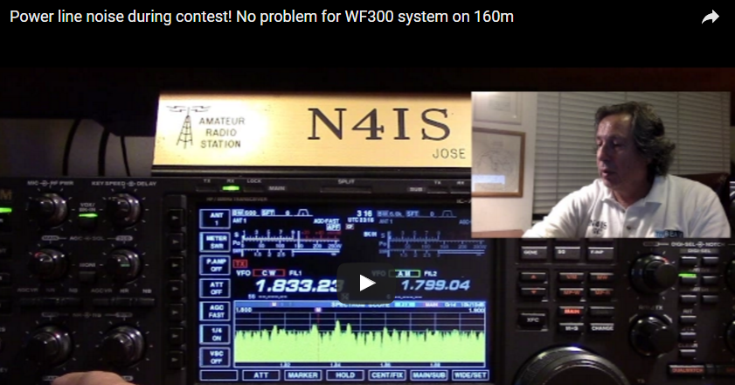
Polarization filter, the HWF, Horizontal Waller Flag
MAN MADE
NOISE REJECTION
https://top-beam.com/contest/power-line-noise-during-contest-no-problem-for-wf300-system-on-160m/
Notes:
Watch the video on TOP-BEAM site,
What is the difference between city lot and a isolated inhabited island on the Bahamas
AA7JV was surprised by propagation noise

Slide 22
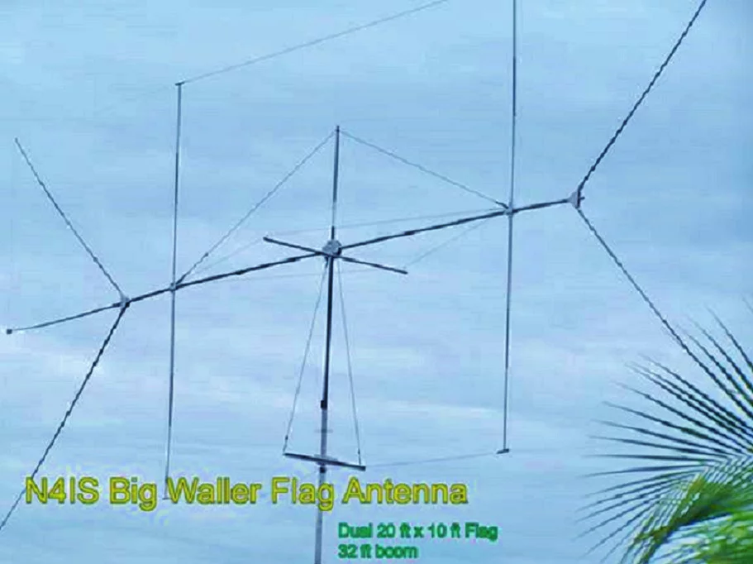
Vertical Waller Flag gain & Frequency N4IS Big VWF
Big VWF LOOPS 20 X 10 ft. 50 ft.
MHz
Notes:
WF increase gain with frequency
Positive gain on high frequency
Low pass filter or band pass filter is necessary to avoid intermodulation on the preamplifier.

Slide 23
HWF Gain change with height above ground
1/16
1/8
1/4
1/2
3/4
1 WAVE LENGTH
0
-.8dB
-.5 dB
-1.7 dB
-5
ANT. HEIGHT | 7 MHz | 3.5 MHz | 1.8 MHz
30 Ft | 1/4 | 1/8 | 1/16
60 Ft | 1/2 | 1/4 | 1/8
120 Ft | 1 | 1/2 | 1/4
240 Ft | 2 | 1 | 1/2
480 FT | 4 | 2 | 1
-6.5 dB
-10
-12 dB
-15
-20
-25
Notes:
Horizontal signal is near the ground is canceled by the reflected wave, -1
Gain increase with height
¼ in 160 is ½ on 80m
Talk about N4II in Boca Raton it does work on 160m at 60ft.
1/8 means 6 db

Slide 24
Waller Flag practical preamplifier gain
BAND | Vertical WF | Horizontal WF | Recommended | Web link for information
160 | 30 db | 40 db | N4IS 6 x BF981 | http://radio-amador.net/pipermail/cluster/attachments/20110115/5fe9bdf5/N4ISBF981six02.pdf
80 | 20 db | 30 db | 2 x Norton | Z10042A Broadband Norton Amplifier ( Will be available DXE)
40 | 10 db | 20 db | 1 x Norton | Z10042A Broadband Norton Amplifier
30 | 10 db | 10 db | 1 x Norton | Z10042A Broadband Norton Amplifier
NF 2 db or less
Input filter HPF or BPF MUST
Output PBF filter Necessary ( pre-selector )
RX/TX switch with 80db isolation or more
RX/TX relay fast 2 msec.
Double shield for N4IS preamp is a must
12VDC choke and any cable in or out needs a choke
Short ground and BNC or SMA connectors with good cable (RG400)
Preamp and filter close to the RADIO
Avoid RF leak from the TX antenna port.
For 5 MHz to 10 MHz, one HPF and only one Norton is recommended
The WF has good performance on High band, no preamplifier needed for 14 MHz up
40 db gain is 10.000 times the input signal
IT NEEDS BEST PRACTICE SHIELDING DECOUPLING
Notes:
N4IS information available on the web , just google N4IS preamplifier
VWF 2 Norton's is the only thing you need
Don’t forget he filters

Slide 25
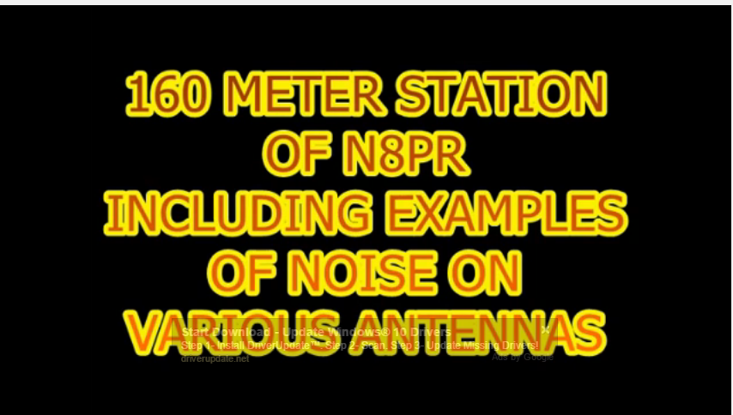
Pin “one” problem and shielding
Attenuation at 1.8 MHz
COAXIAL
ROTOR CABLE
NONE = NIL = 0
ELECTRICAL FIELD
C = 1 nF 3 db Max
MAGNECTIC
Capacitor impedance at 1.8 MHz
1 nF = 88 ohms
10 nF = 8 ohms
100 nF = 0.8 ohms
1uF = 0.08 ohms
GROUND
It is hard to get 20 db attenuation on 160m
Good shield and large capacitors with chokes and inductors, and steel tinplate shield is a must, not a option!
https://www.youtube.com/watch?v=-4os4qcaT08
Notes:
See the video N8PR

Slide 26
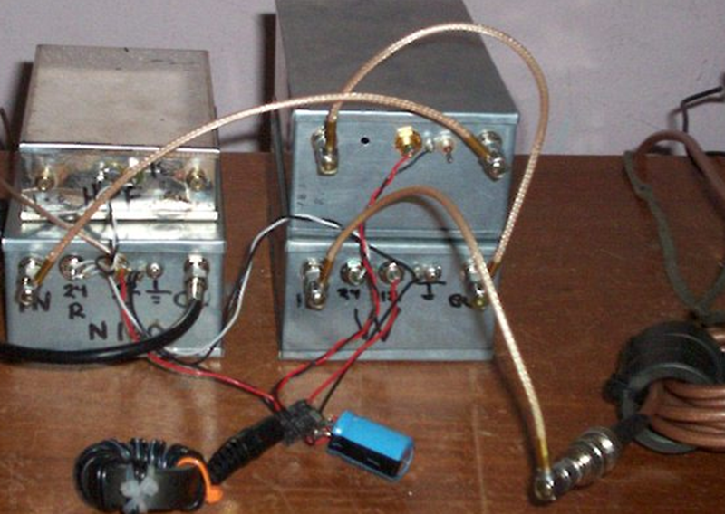
N4IS PREAMPLIFIERS Preamp Filter Interlock Unit
WF system is a one year long project
Low system Noise Figure < 2 dB

Slide 27
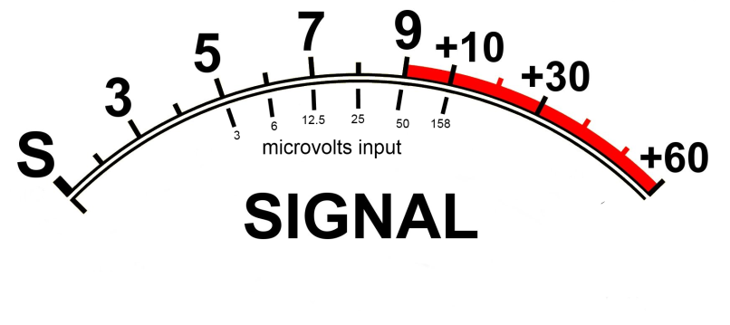

Thermal noise and the S meter for weak signal
S units | dBm
+ 60 | -33
+ 40 | -43
+ 20 | -53
+ 10 | -63
S 9 | - 73
S 8 | -79
S 7 | -85
S 6 | -91
S 5 | -97
S 4 | -103
S 3 | -109
S 2 | -115
S 1 | -121
S 0 | -127
S -1 | -133
S -2 | -139
S -3 | -145
S -5 | -151
S -6 | -157
S/N ratio
SSB 10 db
CW 3 db
NF=2db
BW 1 Hz
MDS -172dBm
Power Watts | dBm | Volts RMS 50 ohms | S Meter
2000 | 63 | 315
1500 | 61.7 | 271
1000 | 60 | 223
500 | 57 | 158
100 | 50 | 70.7
1 | 30 | 7.07
100 mW | 20 | 2.23
10 mW | 10 | .707
1 mW | 0 | .223 | S9 + 73
NF= 20 db SSB BW = 2400 Hz > MDS -120 dBm
NF= 5 db SSB BW = 2400 Hz > MDS -135 dBm
NF= 5 db CW BW = 500 Hz > MDS -142 dBm
NF= 2 db CW BW = 100Hz > MDS -152 dBm
Notes:
There is DX below s0!

Slide 28
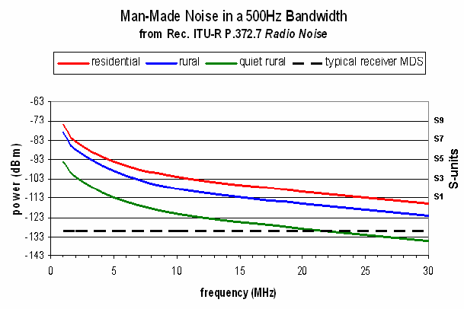
Man-Made Noise in a 500Hz Bandwidth
Man-Made noise vertical polarized ground wave
160
80
40
20
S 9
dBm above receiver noise floor in a 500Hz Bandwidth
S 0
160 m 47 dBm 42 30
80 m 35 dBm 30 22
40 m 20 dBm 15 10
RECEIVER NOISE FLOOR
Notes:
Average ground wave

Slide 29
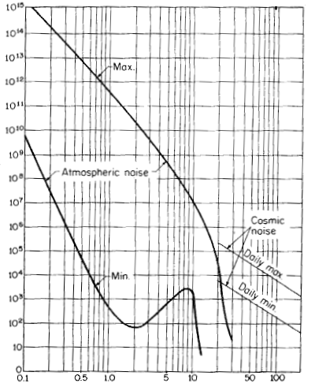
Antenna noise temperature in Kelvin
Noise temperatures at medium and high frequencies Fig 11-44 pg. 414 Edward C. Jordan and Keith G. Balmain -RECOMMENDATION ITU-R P.372-7 - Radio noise*
1.8 MHz
Sky wave propagation noise
Minimum noise during a quiet winter morning can be as low as1.3dB
System Noise Figure of 1.3 dB degrades the signal to noise ratio by 3 dB
The insertion loss of all passive devices adds directly to Noise Figure
N4IS RX system has 1,4 dB NF >>
  IC7800 20 dB NF
  N4IS .5 dB preamplifier (40 dB gain)
  Input Filter .2 dB
WF system operates near the receiver noise floor
2 000 K ~ = 9 dB
Shielding, grounding, isolation and common mode noise reduction is critical
100 K ~ = 1.3 dB
Notes:
Average sky wave

Slide 30
Common mode noise & How many antennas do you have on 160m ?
ANTENNA
COMMON MODE
NOISE
IS THE VOLAGE BETWEEN THE WIRES AND THE COMMON GROUND
ROTOR
TRANSMIT ANTENNA
160m
RF energy can light a bulb near sunset
ALL WIRES AND CONDUCTORS
MORE THAN 90 ft. ( 30m ) LONG
ARE 160m ANTENNAS
ALL RF ENERGY END UP AT
YOUR STATION GROUND
RADIO
AMP
AC LINE
ROTOR
COMMON GROUND = EARTH
Notes:
See N8PR project
Cable TV, Telephone lines

Slide 31
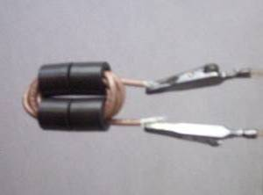
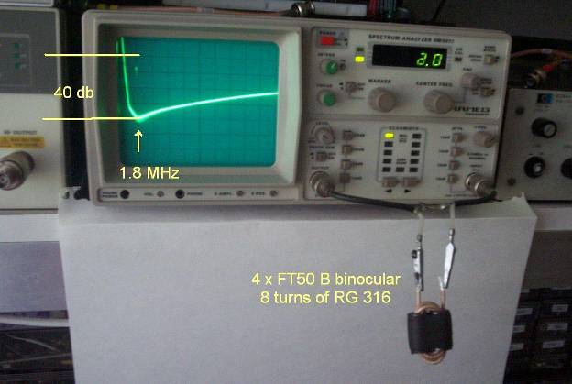
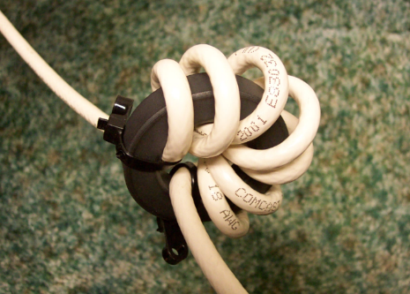
CHOKE is your best friend
Steve Dove W3EEE Reducing EMI Noise on Receive Antennas
http://www.hifidelity.com/w3eee/Noiz%20.html

Slide 32
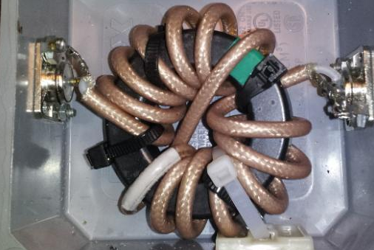
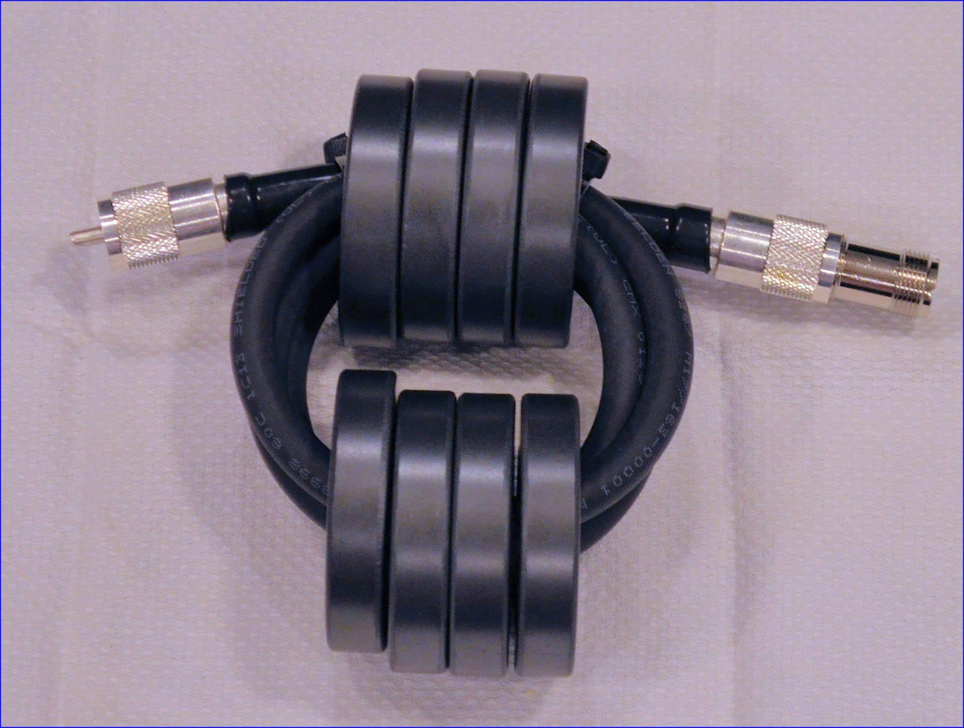
Common mode current runs outside the shield , if you open the shield the noise get’s inside !
CHOKE IS YOUR BEST FRIEND
A Ham's Guide to RFI, Ferrites, Baluns, and Audio Interfacing by Jim Brown K9YC
http://audiosystemsgroup.com/RFI-Ham.pdf
Common-Mode Chokes 1 by Chuck Counselman, W1HIS
http://www.yccc.org/Articles/W1HIS/CommonModeChokesW1HIS2006Apr06.pdf
Notes:
Common mode current runs outside the shield , if you open the shield the noise get’s inside

Slide 33

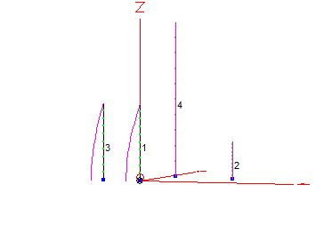
INTERACTION BETWEEN ELEMENTS
FRONT BACK
-1 phase subtract to signal
+1 phase adds to signal
Maximum interaction ½ wave
Minimum interaction ¼ wave or less
DIRECTOR
REFLECTOR
1/2 λ
DRIVEN
1/4 λ
1/4 λ
It is a basic law of physics valid for all
RX antennas
FORWARD GAIN
1/8 λ
TX
Notes:
Explain ½ dipole and ¼ leg, versus ¼ vertical resonant as ½ dipole due the image below the ground.

Slide 34
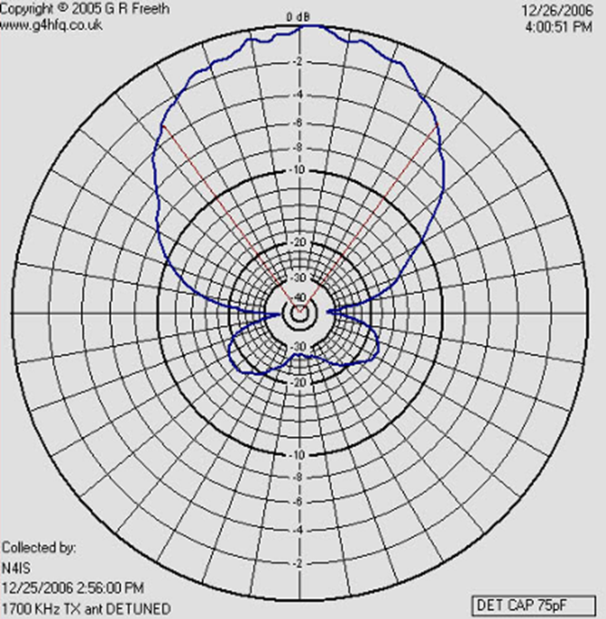
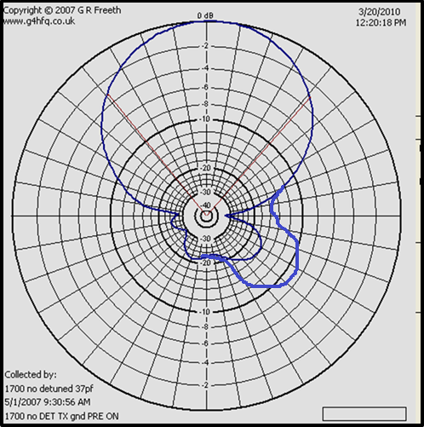
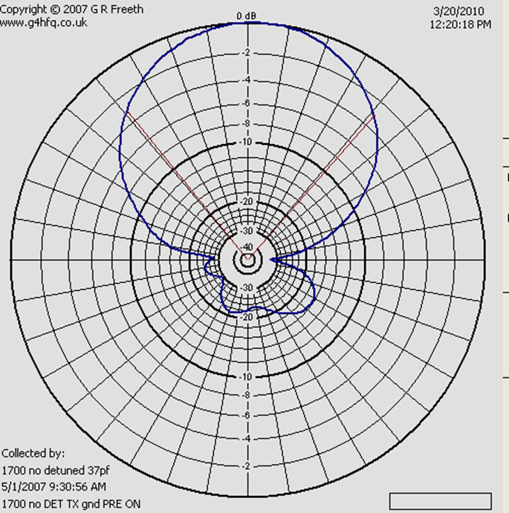
REFLECTED SIGNAL DEGRADING RADIATION PATTERN
DX SIGNAL
DETUNING TX ANTENNA
UP TO -30 db
DX REFLECTED SIGNAL
DX SIGNAL
ISOLATION BETWEEN TX AND RX ANTENNAS
ISOLATION BETWEEN THE BOOM AND THE TOWER
VERTICAL TX & VERTICAL RX = DISTANCE
VERTICAL TX & HORIZONTAL RX = DISTABCE - 27 db
Notes:
Isolate the boom or the tower for vertical WF
HWF works just fine with no detuning.

Slide 35
DEGRADED RADIATION PATTERN
ALL SIGNAL MIXING AT PREAMPLIFIER INPUT
OPEN FRAME RELAY – PLASTIC BOX -OPEN SHIELD CONNECTOR
0 dB
RX SIGNAL FROM WF
-10 dB
-20 dB
TX ANTENNA SIGNAL
COMMON MODE NOISE
PREAMPLIFIER IS PART OF THE RADIO - NOT THE ANTENNA
Notes:
DO NOT INSTALL MAST PREAMP. IT WILL BE IMPOSSIBLE TO CONTROL COMMON MODE NOISE
CHOKE inside preamplifier never big enough, to clean VDC
This is very weak, the antenna gain is -40db, common mode noise must be 60 db below signal

Slide 36
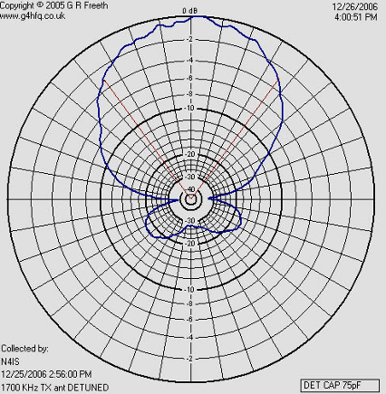
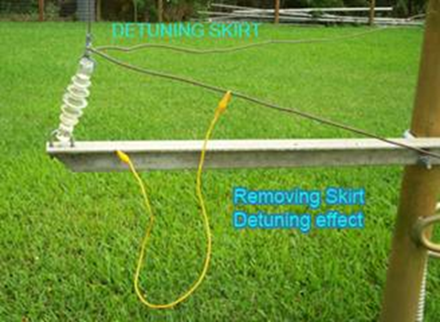
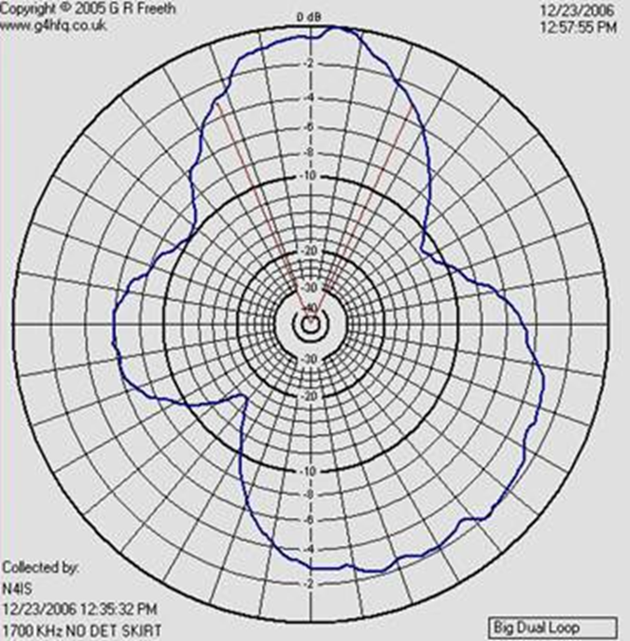
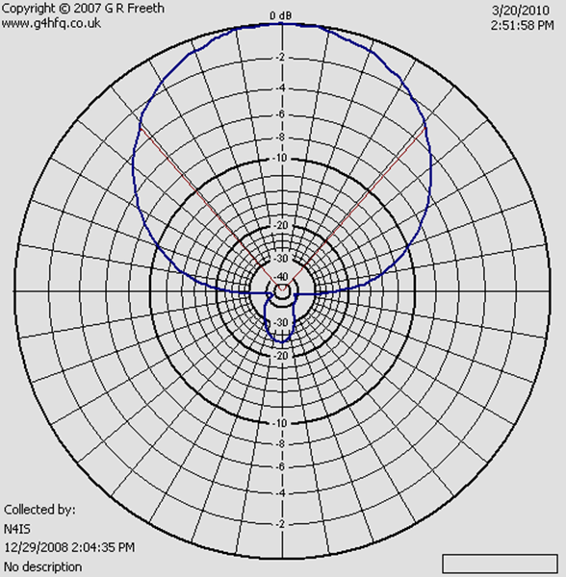
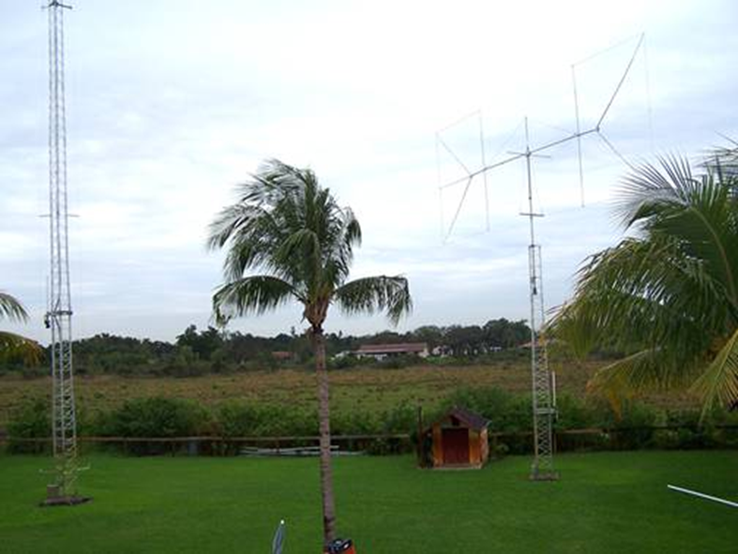
DEGRADED RADIATION PATTERN
60 Ft
TX ANTENNA DETUNED
TX ANTENNA NOT DETUNED

Slide 37
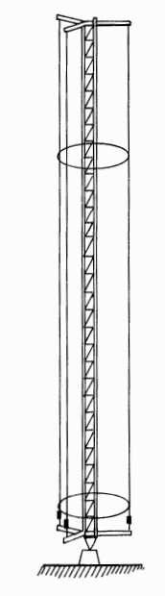
Detuning the tower & Folded Unipole
N8PR -TX antenna Detuning Effects on receive antenna signals
2 ft.
https://www.youtube.com/watch?v=sk6PVl7uaBM
SAME MATERIAL >>
Galvanized steel
How to detune the tower : by Jay Terleski WX0B
http://ncjweb.com/features/novdec05feat.pdf
: by Tom Rauch W8JI
https://www.w8ji.com/detuning_towers.htm
30 to < 120 ft.
ALL CABLES MUST BE INSIDE THE TOWER
AND GROUNDED AT THE TOP AND BOTTTON
C = 500 to 1000 pF
Receiver capacitor
200 ohms
4:1 transformer
or L-C Tuner
Open the jumper
Antenna Analyzer to PL-259
Tune C for R=0
Reconnect the jumper
JUMPER
PL-259
Notes:
Watch the video N8PR
UNIPOLE QST , books AM BC industry.
Broad band 200 kHz (400) on 160m
3.5 to 4 MHz on 80m

Slide 38
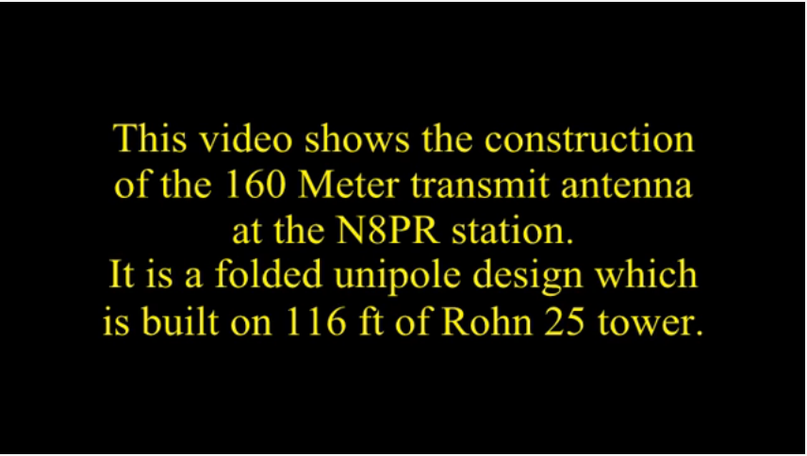
Detuning the tower & Folded Unipole
N8PR -TX antenna Detuning Effects on receive antenna signals
2 ft.
https://www.youtube.com/watch?v=sk6PVl7uaBM
SAME MATERIAL >>
Galvanized steel
How to detune the tower : by Jay Terleski W0XB
http://ncjweb.com/features/novdec05feat.pdf
: by Ton Ranch W8JI
https://www.w8ji.com/detuning_towers.htm
30 to < 120 ft.
ALL CABLES MUST BE INSIDE THE TOWER
AND GROUNDED AT THE TOP AND BOTTTON
C = 500 to 1000 pF
Receiver capacitor
200 ohms
4:1 transformer
or L-C Tuner
Open the jumper
Antenna Analyzer to PL-259
Tune C for R=0
Reconnect the jumper
JUMPER
PL-259
Notes:
Watch the video N8PR
UNIPOLE QST , books AM BC industry.
Broad band 200 kHz (400) on 160m
3.5 to 4 MHz on 80m

Slide 39
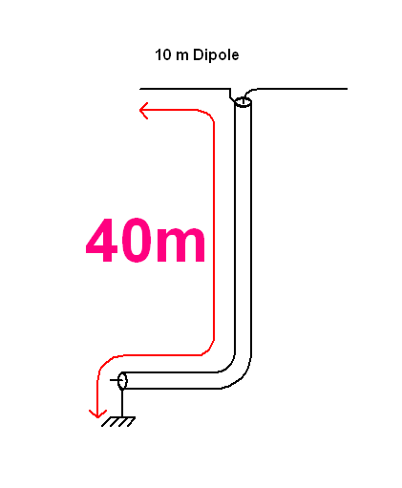
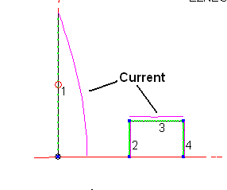
TX antenna is not the only resonant element in your station
ALL CABLES, FEED LINES, ROTOR CABLE AND METAL STRUCTURES MUST BE DETUNED TO PREVENT DEGRADED RADIATION PATTERN
Z out
Common mode
current
120FT = 40 m
re-radiation
Z in
Changing the impedance Zin or Zout
does not detune the feedline cable
Easy way to kill all your RX antennas is;
Low dipole and ¼ wave elevated radials

Slide 40
HOW TO USE POLAR PLOT USING AM BROADCAST SIGNAL
Download POLARPLOT and read instructions >> http://www.g4hfq.co.uk/
Install Polar Plot
Measure the radiation pattern near local noon to avoid sky-waves
Select a vertical signal near as possible 1.8 MHz, 1.6 or 1,7 KHz when available.
Set up radio for CW 100 HZ BW, NB and NR are ok to use when you have some noise.
Turns RF gain very low and then turn AGC OFF.
Adjust AF gain to avoid AF overload on the PC.
Adjust audio to “Calibrate Input” and use Radio Attenuator to check the scale and linearity.
Adjust rotor time “Rotation Time” on the PolarPlot to match the number of seconds you rotor turns 360 degree.
Disconnect TX antenna to avoid signal leak.
Start the rotor at the same time you click “ Collect Data” (SOME ROTORS HAVE DIFFERENT TIME FOR EACH DIRECTION)
Save file with date, time, frequency and antenna type.
A MUST READ WEBSITE http://www.w3eee.com/
Evaluating Receive Antennas with a Soundcard
http://www.w3eee.com/rsgb_1.html
Notes:
Rotor speed not the same on both direction
Use isolation transformer on PC audio card.
Must read website
Print the results and add SWR notes on the paper to compare with last time measurement

Slide 41
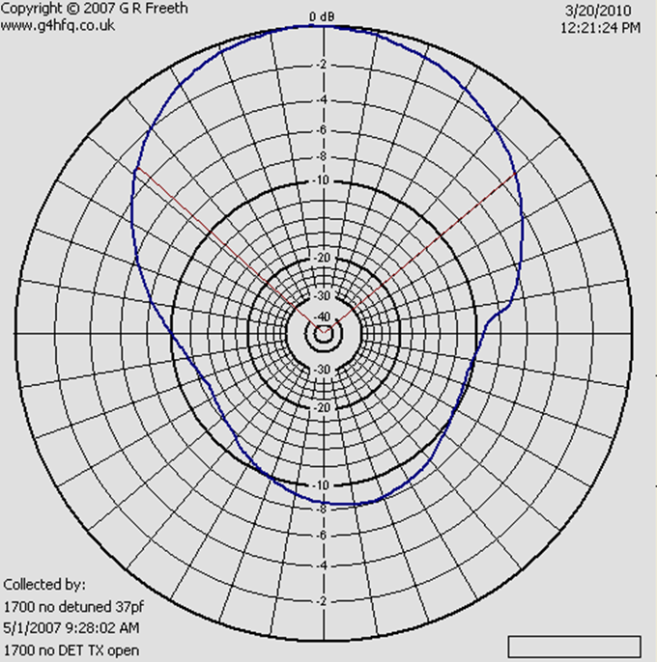
Measuring the WF with PolarPlot WWW.G4HFG.CO.UK
SATURATION
REFLECTED
AUDIO SATURATION NON LINEAR
SIGNAL FROM TWO DIRECTIONS
COMMON MODE NOISE LEAK

Slide 42
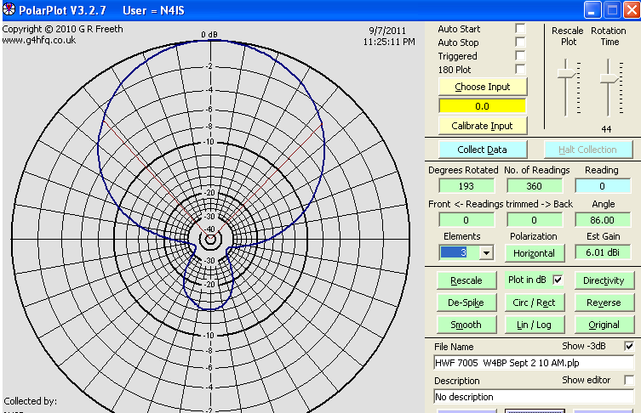
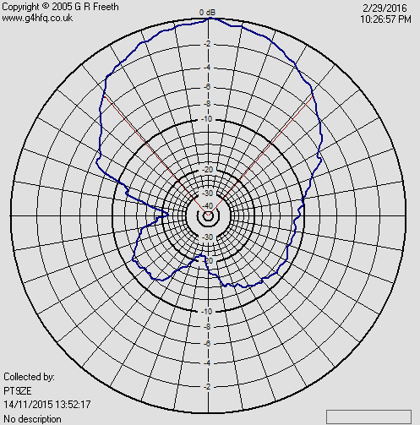

HWF, Horizontal Waller Flag Polarplot 40m

Slide 43


HWF, Horizontal Waller Flag Polarplot 80m / 160m
HORIZONAL SIGNAL & HORIZONTAL WF
VERTICAL SIGNAL & HORIZONTAL WF

Slide 44

Horizontal & Vertical Waller noise floor near noon time
During noon time with quiet weather
Connecting N4IS (40 db gain ) preamp to the radio (internal preamp off) the S meter should be near s0
Connecting the HWF to the N4IS preamp the increase of noise should be zero, No sky wave means no signal on the HWF
If it is not, you have work to do removing common mode noise
Note regarding the plot. BWF is Big Waller Flag, a name given to Vertical Waller Flag when it was first introduced. BWF = VWF

Slide 45

HWF Horizontal Waller 160m N4IS QSL’s from a city lot

Slide 46
Dual loaded loop receiving antenna Historical Evolution
March 5, 1919, Roy A. Weagant, Chief Engineer of the Marconi Wireless Telegraph Co. of America, delivered a paper describing in detail his apparatus for the elimination of the great bug-bear of transoceanic wireless communication -- static interference. >>
http://infoage.org/html/wa-1919-04-p11.html
1938 Harold Beverage invented wide band receiver antenna, loaded loop. The present invention relates to short wave antennas and, more particularly, to antennas for receiving horizontally polarized waves over a wide band of frequencies. An object of the present invention is to enable the reception of horizontally polarized signals over a wide band of frequencies such-as is at present used in television.
https://docs.google.com/viewer?url=patentimages.storage.googleapis.com/pdfs/US2247743.pdf
. Nearly all the newly re-invented compact receive antennas derive from the terminated loop, the earliest reference was in an appallingly mimeographed prewar training manual of W3EEE Dad‘s
1973 COMMUNICATIONS 74 CONFERENCE BRIGHTON Wednesday, June 5 1974 — Session 5 Equipment Design Paper 5.3: Loop Antennas for HF Reception Contributed by: B.S.Collins, C & S Antennas Ltd.,

Slide 47
1995 JF1DMQ wrote an earlier article about the Flag antenna in November 1995 in a Japanese magazine. His was only 3.3 feet by 16.4 feet long (1 by 5 m).K6SE's 160m optimized versions are 14 by 29 feet (4.3 by 8.8m).
"Is This EWE for You?" (QST February, 1995, p.31) and "More EWES for You",
    QST January, 1996, p. 32) both by WA2WVL.
The Pennant was originated by EA3VY and optimized for 160 meters by K6SE, who first wrote about them on the Top Band Reflector in 1998
The K9AY Terminated Loop—A Compact, Directional Receiving Antenna By Gary Breed, K9AY
W7IUV rotatable Flag and preamplifier >> http://w7iuv.com/
2000 QST Magazine, July 2000, page 34 for K6SE's classic article: "Flags, Pennants, and Other Ground- Independent Low-Band Receiving Antennas" ...
2003 NX4D developed the first dual flag vertical array
N4IS developed the BIG flag vertical array >> www.n4is.com
N4IS developed the Horizontal flag array
Dr Dallas Lankford, wrote the Flag Theory and design the Quad Flag Array >> http://www.kongsfjord.no/dl/dl.htm
AA7JV George Wallner developed the DHDL (TX3A) >> http://tx3a.com/docs/TX3A_DOUBLE_HALF_DELTA_LOOP.ZIP
DOUBLING the Double Half-Delta Loop Receiving Antenna
    by Pierluigi “Luis” Mansutti IV3PRK >> http://www.iv3prk.it/user/image/..-rxant.prk_tx3a.pdf

Slide 48
Pre War terminated loop
Pre War terminated loop
THE RADIATION PATTERN OF LOOP ANTENNAS
The current which flows in a loop antenna may be represented by a Fourier series of cosine and sine terms. The zero order term represents a constant current flowing around the hop and gives rise to the familiar figure-of-eight radiation pattern typical of a small loop.
The odd order (sine) terms represent the currents which flow in the same direction in both sides of the loop and therefore do not give rise to any output voltage across a balanced terminating impedance. The azimuth radiation pattern associated with this current mode in a small loop is circular. When the loop is fed with an unbalanced feed both even and odd modes can exist. The total radiation pattern of the loop will be the sum of those due to the separate modes. The zero order mode predominates in a simple loop; in order to obtain a cardioid radiation pattern the amplitude of the zero order mode current must be reduced relative to the first order mode current, and the relative phase of the currents must be adjusted so that the cancellation obtained in the rearwards direction is complete. This result can be achieved by inserting a suitable impedance in series with the loop at a point diametrically opposite the feed point.
The terminated loop exhibits a near cardioid azimuth radiation pattern for vertically polarized incident energy and an input impedance which may easily be matched to 50 ohms.

